Slide 1





Framework Examples: Part 1
Douglas C. Schmidt
d.schmidt@vanderbilt.edu
www.dre.vanderbilt.edu/~schmidt
Professor of Computer Science
Institute for Software Integrated Systems Vanderbilt University Nashville, Tennessee, USA

Slide 2
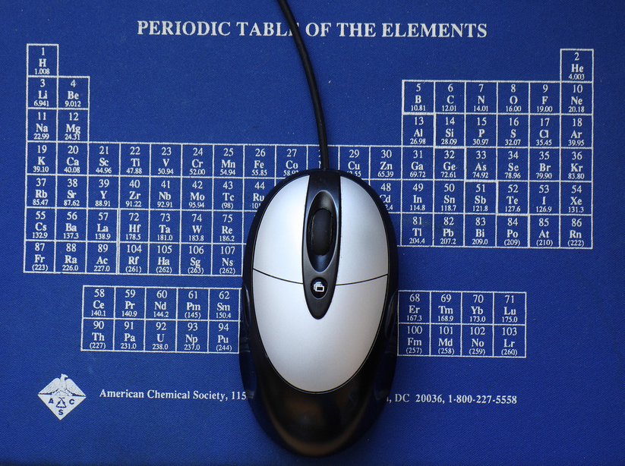
Topics Covered in this Part of the Module
Present Scope, Commonality, & Variability (SCV) analysis as a method for developing & applying software product-lines & frameworks

Slide 3
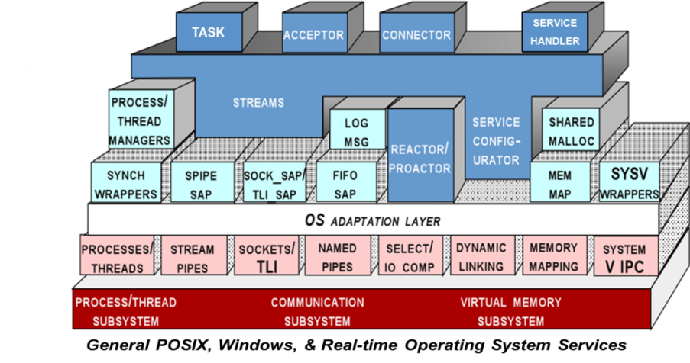
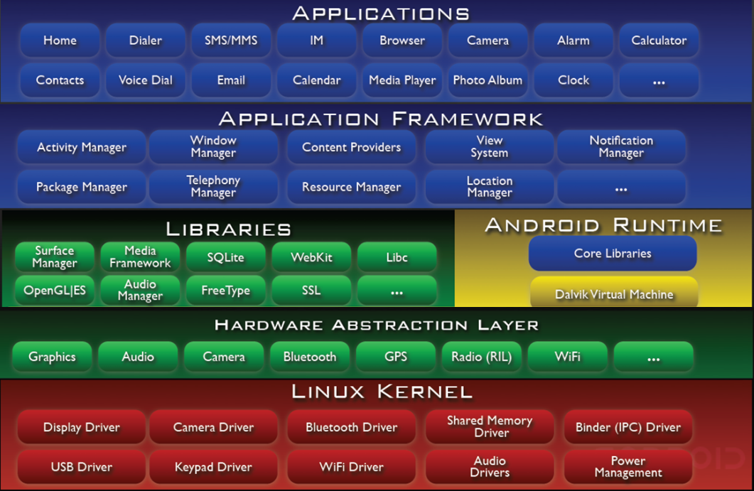


Topics Covered in this Part of the Module
Present Scope, Commonality, & Variability (SCV) analysis as a method for developing & applying software product-lines & frameworks
Illustrate the application of SCV to Android & ACE

Slide 4




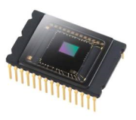
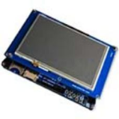
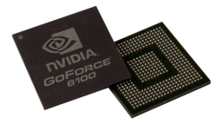
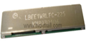
Overview of Software Product-Lines
A software product line (SPL) is a form of systematic software reuse
An SPL a set of software-intensive systems
These systems share a common, managed set of features satisfying the specific needs of a particular market segment or mission
They are developed from a common set of core assets in a prescribed way
Product
Variant 1
Product
Variant 2
Product
Variant 3
Product
Variant 4
Bundled & Third-Party Apps
Application Frameworks
System Libraries
Virtual Machine Runtime
Operating System Kernel
Notes:
http://www.flickr.com/photos/43145783@N00/1852428153/

Slide 5
Overview of Software Product-Lines
A software product line (SPL) is a form of systematic software reuse
An SPL a set of software-intensive systems
These systems share a common, managed set of features satisfying the specific needs of a particular market segment or mission
They are developed from a common set of core assets in a prescribed way
Frameworks (& patterns) can help define & improve core SPL assets by factoring out many reusable general-purpose & domain-specific services from application responsibility
Product
Variant 1
Product
Variant 2
Product
Variant 3
Product
Variant 4
Bundled & Third-Party Apps
Application Frameworks
System Libraries
Virtual Machine Runtime
Operating System Kernel
See www.sei.cmu.edu/productlines for more info on software product-lines
Notes:
http://www.flickr.com/photos/43145783@N00/1852428153/

Slide 6

Scope, Commonality, & Variability Analysis
Key software product-line & framework structure & behavior can be captured systematically via Scope, Commonality, & Variability (SCV) analysis
Notes:
http://www.flickr.com/photos/43145783@N00/1852428153/

Slide 7
Scope, Commonality, & Variability Analysis
Key software product-line & framework structure & behavior can be captured systematically via Scope, Commonality, & Variability (SCV) analysis
This process can be applied to identify commonalities & variabilities in a domain
Notes:
http://www.flickr.com/photos/8510225@N07/4319584679/

Slide 8
Scope, Commonality, & Variability Analysis
Key software product-line & framework structure & behavior can be captured systematically via Scope, Commonality, & Variability (SCV) analysis
This process can be applied to identify commonalities & variabilities in a domain
This analysis can guide the development & application of software product-lines & frameworks
Product
Variant 1
Product
Variant 2
Product
Variant 3
Product
Variant 4
Bundled & Third-Party Apps
Application Frameworks
System Libraries
Virtual Machine Runtime
Operating System Kernel
www.cs.iastate.edu/~cs309/references/CoplienHoffmanWeiss_CommonalityVariability.pdf
Notes:
http://www.flickr.com/photos/8510225@N07/4319584679/

Slide 9
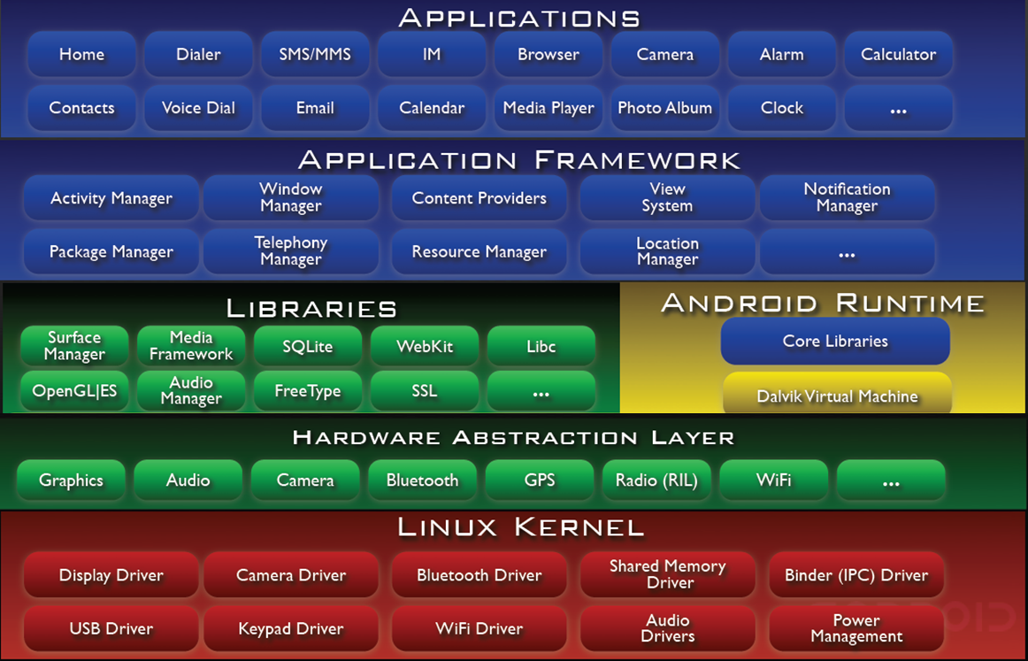
Applying SCV to Android
Scope defines the domain & context of Android & its various frameworks & components
e.g.,
Resource-constrained mobile devices
e.g., limited power, memory, processors, network, & price points
Notes:
http://www.flickr.com/photos/83346641@N00/6051805616/

Slide 10
Applying SCV to Android
Scope defines the domain & context of Android & its various frameworks & components
e.g.,
Resource-constrained mobile devices
e.g., limited power, memory, processors, network, & price points
Touch-based user interfaces
Notes:
http://www.flickr.com/photos/83346641@N00/6051805616/

Slide 11
Applying SCV to Android
Scope defines the domain & context of Android & its various frameworks & components
e.g.,
Resource-constrained mobile devices
e.g., limited power, memory, processors, network, & price points
Touch-based user interfaces
(Largely) open-source, vendor- & hardware-agnostic ecosystem
Notes:
http://www.flickr.com/photos/83346641@N00/6051805616/

Slide 12
Applying SCV to Android
Scope defines the domain & context of Android & its various frameworks & components
e.g.,
Resource-constrained mobile devices
e.g., limited power, memory, processors, network, & price points
Touch-based user interfaces
(Largely) open-source, vendor- & hardware-agnostic ecosystem
Focus on installed-base of Java app developers
See developer.android.com for more info on Android
Notes:
http://www.flickr.com/photos/83346641@N00/6051805616/

Slide 13
Applying SCV to Android
Commonalities describe the attributes common across all instances of Android
Common framework components
e.g., Activities, Services, Content Providers, & Broadcast Receivers
Notes:
http://www.flickr.com/photos/83346641@N00/6051805616/

Slide 14
Applying SCV to Android
Commonalities describe the attributes common across all instances of Android
Common framework components
e.g., Activities, Services, Content Providers, & Broadcast Receivers
Common application frameworks
e.g., Activity Manager, Package Manager, Telephony Manager, Location Manager, Notification Manager, etc.
Notes:
http://www.flickr.com/photos/83346641@N00/6051805616/

Slide 15
Applying SCV to Android
Commonalities describe the attributes common across all instances of Android
Common framework components
e.g., Activities, Services, Content Providers, & Broadcast Receivers
Common application frameworks
e.g., Activity Manager, Package Manager, Telephony Manager, Location Manager, Notification Manager, etc.
Common infrastructure
e.g., Intent framework, Binder, Webkit, Hardware Abstraction Layer, OS device driver frameworks etc.
Notes:
http://www.flickr.com/photos/83346641@N00/6051805616/

Slide 16
Applying SCV to Android
Variabilities describe the attributes unique to different instantiations of Android
Product-dependent components
e.g., different “look & feel” variants of vendor-specific user interfaces, sensor & device properties, etc.

Slide 17
Applying SCV to Android
Variabilities describe the attributes unique to different instantiations of Android
Product-dependent components
e.g., different “look & feel” variants of vendor-specific user interfaces, sensor & device properties, etc.
Product-dependent component assemblies
e.g., different bundled apps, CDMA vs. GSM & different hardware, OS, & network/bus configurations, etc.
SCV can also be applied recursively for all the Android frameworks & layers

Slide 18
Applying SCV Analysis to ACE
Scope defines the domain & context of the ADAPTIVE Communication Environment (ACE)
e.g.,
Object-oriented host infrastructure middleware
Encapsulates many tedious & error-prone aspects of low-level OS APIs for concurrent & networked software
Enhances native OS mechanisms to create reusable C++ components

Slide 19
Applying SCV Analysis to ACE
Scope defines the domain & context of the ADAPTIVE Communication Environment (ACE)
e.g.,
Object-oriented host infrastructure middleware
Encapsulates many tedious & error-prone aspects of low-level OS APIs for concurrent & networked software
Enhances native OS mechanisms to create reusable C++ components
Open-source vendor- & OS-agnostic ecosystem

Slide 20
Applying SCV Analysis to ACE
Scope defines the domain & context of the ADAPTIVE Communication Environment (ACE)
e.g.,
Object-oriented host infrastructure middleware
Encapsulates many tedious & error-prone aspects of low-level OS APIs for concurrent & networked software
Enhances native OS mechanisms to create reusable C++ components
Open-source vendor- & OS-agnostic ecosystem
Focused on C++ software developers, particularly those developing infrastructure software & distributed real-time & embedded (DRE) systems
See www.dre.vanderbilt.edu/ACE for more info on ACE

Slide 21
Applying SCV Analysis to ACE
Commonalities describe the attributes common across all instances of ACE
C portability APIs
“POSIX-like” OS adaptation layer that shields other layers & components in ACE from platform-specific dependencies
C portability APIs

Slide 22
Applying SCV Analysis to ACE
Commonalities describe the attributes common across all instances of ACE
C portability APIs
“POSIX-like” OS adaptation layer that shields other layers & components in ACE from platform-specific dependencies
C++ wrapper facades
Provides type-safe C++ interfaces that encapsulate native OS concurrency, communication, memory management, event demultiplexing, dynamic linking, & file system APIs
C++ Wrapper Facades

Slide 23
Applying SCV Analysis to ACE
Commonalities describe the attributes common across all instances of ACE
C portability APIs
“POSIX-like” OS adaptation layer that shields other layers & components in ACE from platform-specific dependencies
C++ wrapper facades
Provides type-safe C++ interfaces that encapsulate native OS concurrency, communication, memory management, event demultiplexing, dynamic linking, & file system APIs
C++ frameworks
e.g., Sync/async event handling, connection setup & service initialization, dynamic configuration, concurrency, & layered service composition
C++ Frameworks

Slide 24
Applying SCV Analysis to ACE
Variabilities describe the attributes unique to different instantiations of ACE
Product- & domain- dependent components
e.g., different internal implementations depending on the underlying OS

Slide 25
Applying SCV Analysis to ACE
Variabilities describe the attributes unique to different instantiations of ACE
Product- & domain- dependent components
e.g., different internal implementations depending on the underlying OS
Product-dependent component assemblies
e.g., different subsets of ACE components depending on constraints of the operating environment & user domain requirements
SCV can also be applied recursively for all the ACE frameworks & layers

Slide 26
Summary
Scope, Commonality, & Variability (SCV) analysis is an advanced systematic reuse technique
It helps developers alleviate problems associated with maintaining many versions of the same product that have large amounts of similar software created to satisfy new & diverse requirements
Product
Variant 1
Product
Variant 2
Product
Variant 3
Product
Variant 4
Bundled & Third-Party Apps
Application Frameworks
System Libraries
Virtual Machine Runtime
Operating System Kernel

Slide 27

Summary
Scope, Commonality, & Variability (SCV) analysis is an advanced systematic reuse technique
It helps developers alleviate problems associated with maintaining many versions of the same product that have large amounts of similar software created to satisfy new & diverse requirements
The frameworks in Android & ACE form software product-lines that enable systematic software reuse across a wide range of apps & infrastructure platforms

Slide 28
Framework Examples: Part 2
Douglas C. Schmidt
d.schmidt@vanderbilt.edu
www.dre.vanderbilt.edu/~schmidt
Professor of Computer Science
Institute for Software Integrated Systems Vanderbilt University Nashville, Tennessee, USA

Slide 29
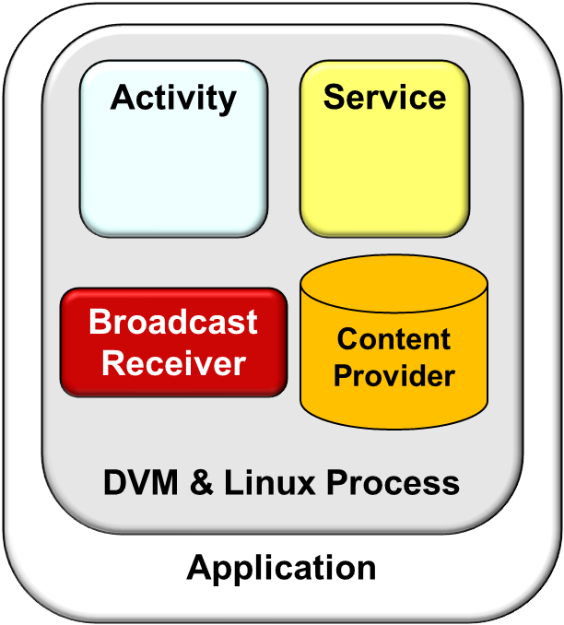
Topics Covered in this Part of the Module
Present Scope, Commonality, & Variability (SCV) analysis as a method for developing & applying software product-lines & frameworks
Illustrate the application of SCV to the Android & ACE platforms
Describe examples of Android framework components
We’ll emphasize commonalities & variabilities in our discussion

Slide 30
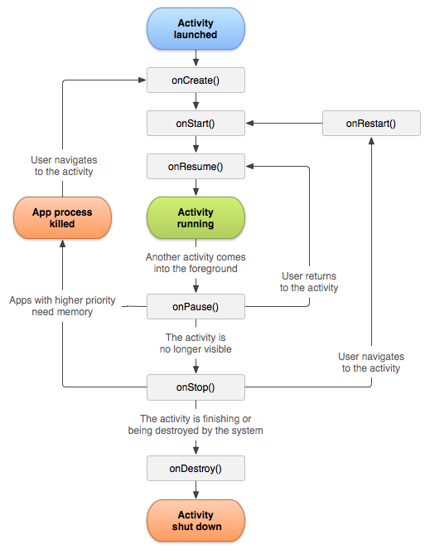
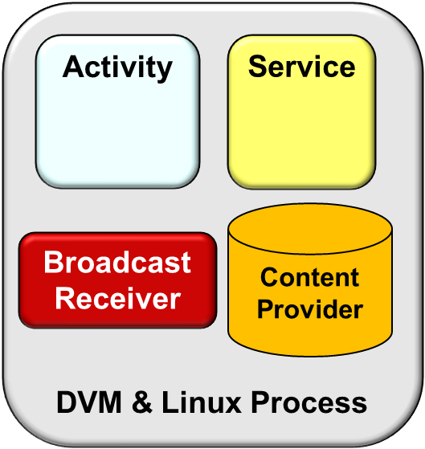
Example Android Framework Components
Activity – Provides a visual interface for user interaction

Slide 31
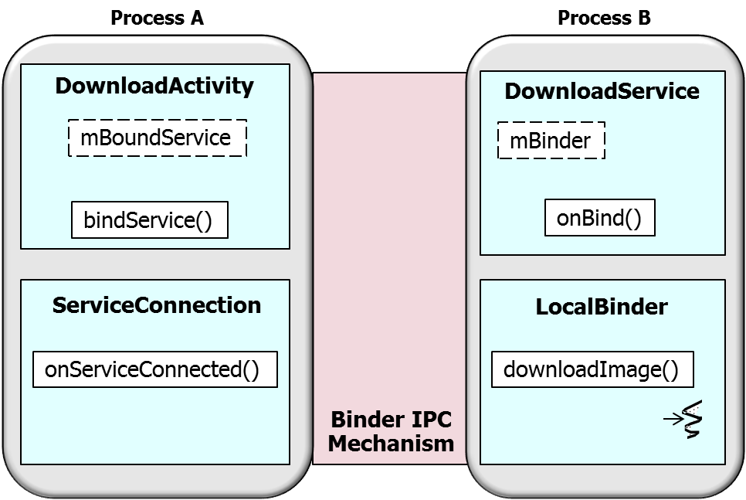
Example Android Framework Components
Activity – Provides a visual interface for user interaction
Service – Runs in background to perform long-running operations or to access remote resources

Slide 32
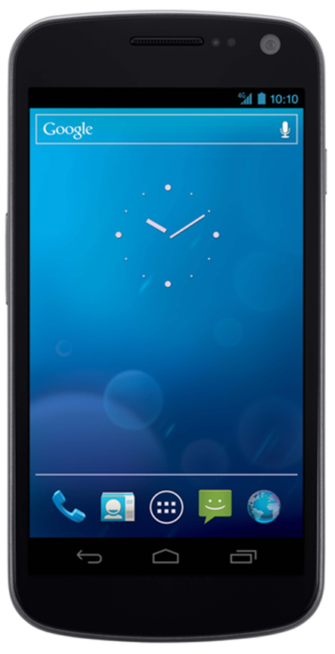
Recap of an Android Activity
An Activity provides a visual interface for user interaction

Slide 33

Recap of an Android Activity
An Activity provides a visual interface for user interaction
Typically supports one thing a user can do, e.g.:
View an email message
Show a login screen
Download a file from a remote server

Slide 34
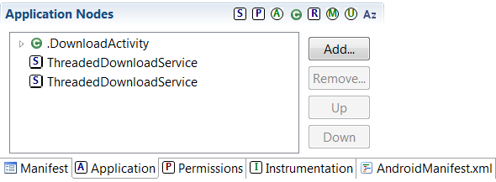
Recap of an Android Activity
An Activity provides a visual interface for user interaction
Typically supports one thing a user can do, e.g.:
View an email message
Show a login screen
Download a file from a remote server
Applications can include one or more activities
See developer.android.com/training/basics/activity-lifecycle/index.html for more

Slide 35
Implementing an Activity
Implementing an Activity involves several steps
e.g., inherit from Activity class, override lifecycle hook methods, include Activity in the config file AndroidManifest.xml, etc.
public class Activity extends ...{
protected void onCreate (Bundle savedInstanceState);
protected void onStart();
protected void onRestart();
protected void onResume();
protected void onPause();
protected void onStop();
protected void onDestroy();
...
}

Slide 36
Implementing an Activity
Implementing an Activity involves several steps
e.g., inherit from Activity class, override lifecycle hook methods, include Activity in the config file AndroidManifest.xml, etc.
Android communicates state changes to an Activity by calling its lifecycle hook methods

Slide 37
Implementing an Activity
Implementing an Activity involves several steps
e.g., inherit from Activity class, override lifecycle hook methods, include Activity in the config file AndroidManifest.xml, etc.
Android communicates state changes to an Activity by calling its lifecycle hook methods
Commonality: Provides common interface for interacting with user, including operations performed when moving between lifecycle states
Variability: Subclasses can override lifecycle hook methods to do necessary work when an Activity changes state

Slide 38
Activity Lifecycle States
Activity starting – Initialization steps
startActivity()
Starting
onCreate(), onStart(), onResume()

Slide 39
Activity Lifecycle States
Activity starting – Initialization steps
Activity running
Running – visible, has focus
Paused – visible, does not have focus, can be terminated
Stopped – not visible, does not have focus, can be terminated
startActivity()
Starting
onCreate(), onStart(), onResume()
onPause()
onRestart(), onStart(), onResume()
Running
onPause()
Paused
Stopped
onStop()

Slide 40
Activity Lifecycle States
Activity starting – Initialization steps
Activity running
Running – visible, has focus
Paused – visible, does not have focus, can be terminated
Stopped – not visible, does not have focus, can be terminated
Activity shut down – Voluntarily finished or involuntarily killed by the system
startActivity()
Starting
onCreate(), onStart(), onResume()
onPause()
onRestart(), onStart(), onResume()
Running
onPause()
Paused
Stopped
onStop()
<process killed>
onDestroy(), <process killed>
Destroyed
See developer.android.com/guide/components/activities.html for more info

Slide 41
Activity Lifecycle Hook Methods
The Android runtime calls hook methods on an Activity to control its lifecycle:
onCreate() – called to initialize an Activity when it is first created

Slide 42
Activity Lifecycle Hook Methods
The Android runtime calls hook methods on an Activity to control its lifecycle:
onCreate() – called to initialize an Activity when it is first created
onStart() – called when Activity is becoming visible to the user

Slide 43
Activity Lifecycle Hook Methods
The Android runtime calls hook methods on an Activity to control its lifecycle:
onCreate() – called to initialize an Activity when it is first created
onStart() – called when Activity is becoming visible to the user
onResume() – called when user returns to an Activity from another

Slide 44
Activity Lifecycle Hook Methods
The Android runtime calls hook methods on an Activity to control its lifecycle:
onCreate() – called to initialize an Activity when it is first created
onStart() – called when Activity is becoming visible to the user
onResume() – called when user returns to an Activity from another
onPause() – called when user leaves an Activity that’s still visible in background

Slide 45
Activity Lifecycle Hook Methods
The Android runtime calls hook methods on an Activity to control its lifecycle:
onCreate() – called to initialize an Activity when it is first created
onStart() – called when Activity is becoming visible to the user
onResume() – called when user returns to an Activity from another
onPause() – called when user leaves an Activity that’s still visible in background
onStop() – called when user leaves an Activity for another

Slide 46
Activity Lifecycle Hook Methods
The Android runtime calls hook methods on an Activity to control its lifecycle:
onCreate() – called to initialize an Activity when it is first created
onStart() – called when Activity is becoming visible to the user
onResume() – called when user returns to an Activity from another
onPause() – called when user leaves an Activity that’s still visible in background
onStop() – called when user leaves an Activity for another
onDestroy() – called when Activity is being released & needs to clean up its allocated resources
See developer.android.com/reference/android/app/Activity.html for more info

Slide 47
Useful Helper Class for Activity Lifecycle Methods
public abstract class LifecycleLoggingActivity extends Activity {
public void onCreate(Bundle savedInstanceState) {
super.onCreate(savedInstanceState);
Log.d(getClass().getSimpleName(), "onCreate()");
if (savedInstanceState == null)
Log.d(getClass().getSimpleName(), "activity created anew");
else
Log.d(getClass().getSimpleName(), "activity restarted");
}
public void onStart() {
super.onStart();
Log.d(getClass().getSimpleName(), "onStart()");
}
...
Inherit from Activity class
Automatically log lifecycle hook method calls
Note the “inversion of control” in the Android Activity framework

Slide 48
Recap of an Android Service
A Service is an app component that can perform long-running operations in the background & does not provide direct access to the user interface
e.g., a service might handle network transactions, play music, perform file I/O, interact with a content provider, or run periodic tasks
1: Activity calls downloadImage() with image URL
Download Service
2: Sends GET request to web server
3: Stores downloaded image in filesystem & metadata in Content Provider
Image Metadata Content Provider
Image Files
See www.dre.vanderbilt.edu/~schmidt/cs282 for info on this app

Slide 49
Recap of an Android Service
A Service is an app component that can perform long-running operations in the background & does not provide direct access to the user interface
e.g., a service might handle network transactions, play music, perform file I/O, interact with a content provider, or run periodic tasks
Another app component can start a service & it will continue to run in the background even if the user switches to another app/activity
1: Activity calls downloadImage() with image URL
Download Service
2: Sends GET request to web server
3: Stores downloaded image in filesystem & metadata in Content Provider
Image Metadata Content Provider
Image Files

Slide 50
Recap of an Android Service
A Service is an app component that can perform long-running operations in the background & does not provide direct access to the user interface
e.g., a service might handle network transactions, play music, perform file I/O, interact with a content provider, or run periodic tasks
Another app component can start a service & it will continue to run in the background even if the user switches to another app/activity
Components can also bind to services to interact with them & perform local or remote IPC
1: Activity calls downloadImage() with image URL
Download Service
2: Sends GET request to web server
3: Stores downloaded image in filesystem & metadata in Content Provider
Image Metadata Content Provider
Image Files
See developer.android.com/guide/components/services.html for more info

Slide 51
Implementing a Service
Implementing a Service is similar to implementing an Activity
e.g., inherit from Android Service class, override lifecycle methods, include Service in the config file AndroidManifest.xml, etc.
public class Service extends ... {
public void onCreate();
public int onStartCommand (Intent intent, int flags, int startId);
public abstract IBinder onBind(Intent intent);
public boolean
onUnbind(Intent intent); protected void onDestroy();
...
}

Slide 52
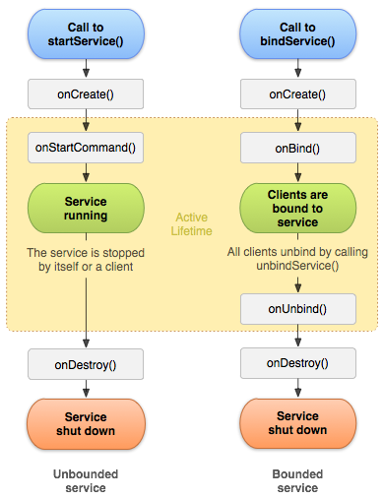
Implementing a Service
Implementing a Service is similar to implementing an Activity
e.g., inherit from Android Service class, override lifecycle methods, include Service in the config file AndroidManifest.xml, etc.
Android communicates state changes to a Service by calling its lifecycle hook methods

Slide 53
Implementing a Service
Implementing a Service is similar to implementing an Activity
e.g., inherit from Android Service class, override lifecycle methods, include Service in the config file AndroidManifest.xml, etc.
Android communicates state changes to a Service by calling its lifecycle hook methods
Commonality: Provides common interface for performing long-running operations that don’t interact directly with the user interface
Variability: Subclasses can override lifecycle hook methods to perform necessary initialization for Started & Bound Services

Slide 54
Service Lifecycle Hook Methods
Services lifecycle methods include
onCreate() – called when Service process is created, by any means

Slide 55
Service Lifecycle Hook Methods
Services lifecycle methods include
onCreate() – called when Service process is created, by any means
onStartCommand() – called each time Service is sent a command via startService()

Slide 56
Service Lifecycle Hook Methods
Services lifecycle methods include
onCreate() – called when Service process is created, by any means
onStartCommand() – called each time Service is sent a command via startService()
onBind()/onUnbind – called when a client binds/unbinds to Service via bindService()/unBindService()

Slide 57
Service Lifecycle Hook Methods
Services lifecycle methods include
onCreate() – called when Service process is created, by any means
onStartCommand() – called each time Service is sent a command via startService()
onBind()/onUnbind – called when a client binds/unbinds to Service via bindService()/unBindService()
onDestroy() – called as Service is being shut down to cleanup resources
Services do not automatically run in their own processes or threads

Slide 58
ThreadedDownloadService Example
public class ThreadedDownloadService extends Service {
public int onStartCommand(Intent intent, int flags, int startId) {
super.onStartCommand( intent, flags, startId );
String downloadType = intent.getCharSequenceExtra ("DOWNLOAD_TYPE").toString();
if (downloadType.equals("messenger"))
threadMessengerDownload(intent);
else if (downloadType.equals("pending_intent"))
threadPendingIntentDownload( intent );
else if (downloadType.equals("asynctask")
asyncTaskDownload(intent);
return Service.START_STICKY;
}
Inherit from Service class
Lifecycle hook method downloads image via various concurrency & IPC mechanisms
Instruct Android to run ThreadedDownloadService in its own process
<service android:name="ThreadedDownloadService“ android:process=":my_process"/>
Note the “inversion of control” in the Android Service framework

Slide 59
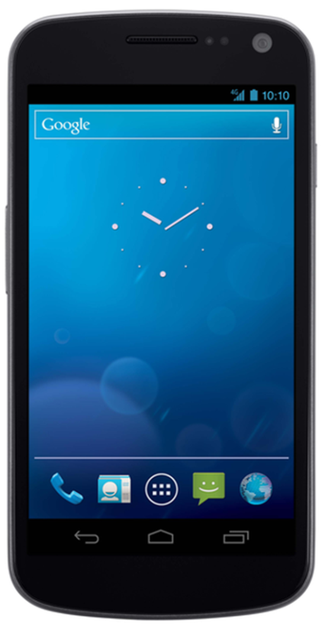
Summary
Android’s framework components support inversion of control & embody many commonalities & variabilities of mobile app development

Slide 60

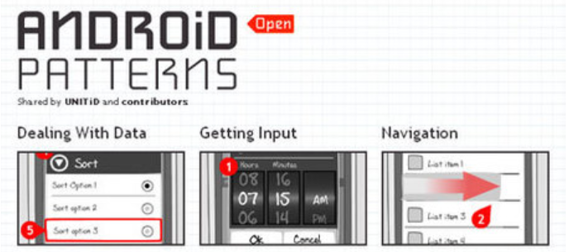
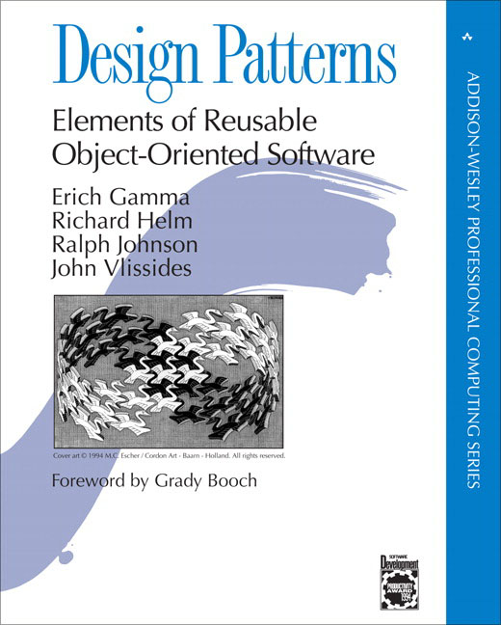
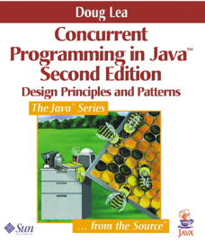
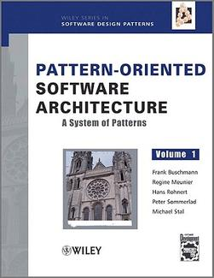

Summary
Android’s framework components support inversion of control & embody many commonalities & variabilities of mobile app development
There are many patterns in Android
Both at the infrastructure & app levels
www.androidpatterns.com
www.androiddesignpatterns.com

Slide 61
Framework Examples: Part 3
Douglas C. Schmidt
d.schmidt@vanderbilt.edu
www.dre.vanderbilt.edu/~schmidt
Professor of Computer Science
Institute for Software Integrated Systems Vanderbilt University Nashville, Tennessee, USA

Slide 62

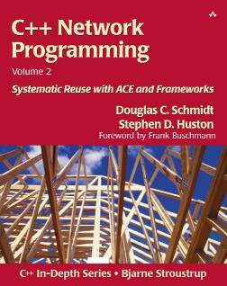
Topics Covered in this Part of the Module
Application-specific functionality
Present Scope, Commonality, & Variability (SCV) analysis as a method for developing & applying software product-lines & frameworks
Illustrate the application of SCV to the Android & ACE platforms
Describe examples of Android framework components
Describe examples of ACE framework components
Acceptor- Connector
Streams
Service Configurator
Reactor
Task
Proactor
Again, we emphasize commonalities & variabilities in our discussion

Slide 63
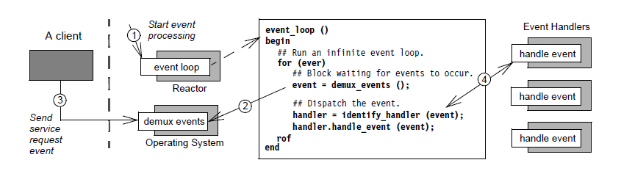
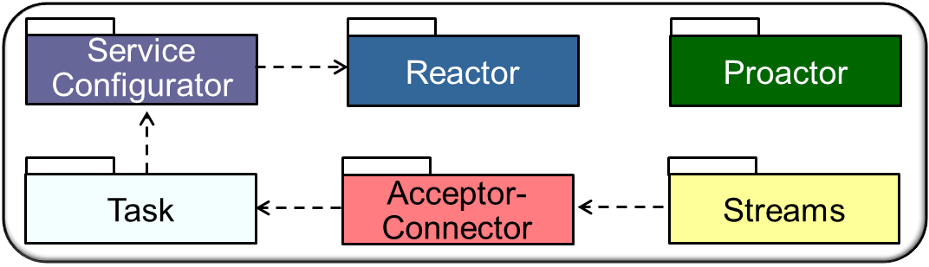
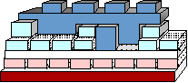
Example ACE Frameworks
Reactor – Handling of synchronous initiation events
Event Handlers
handle_input
run_event_loop
handle_output
handle_signal
See www.dre.vanderbilt.edu/~schmidt/PDF/reactor-rules.pdf for more info

Slide 64
Example ACE Frameworks
Reactor – Handling of synchronous initiation events
Event Handlers
handle_input
run_event_loop
handle_output
handle_signal
Commonality: Common interface for handling timers, signals, & I/O events synchronously
Variability: Supports different synchronous event detection, demuxing, & dispatching implementations

Slide 65
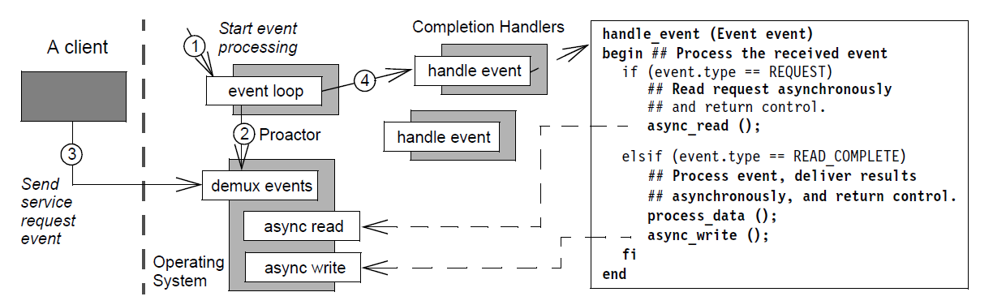
Example ACE Frameworks
Proactor – Handling of asynchronous completion events
handle_accept
run_event_loop
ACE_ Proactor
handle_read_stream
See www.dre.vanderbilt.edu/~schmidt/PDF/proactor.pdf for more info

Slide 66
Example ACE Frameworks
Proactor – Handling of asynchronous completion events
handle_accept
run_event_loop
ACE_ Proactor
handle_read_stream
Commonality: Common interface for handling asynchronous timer & I/O events
Variability: Supports different asynchronous event detection, demuxing, & dispatching implementations

Slide 67
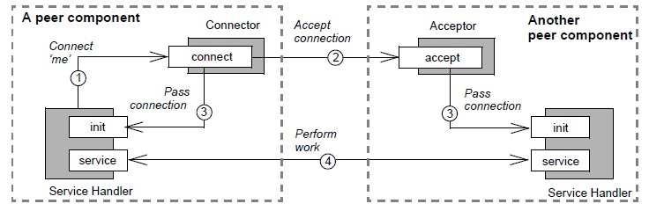
Example ACE Frameworks
Acceptor-Connector – Automates connection setup & service initialization
connect
accept
See www.dre.vanderbilt.edu/~schmidt/PDF/Acc-Con.pdf for more info

Slide 68
Example ACE Frameworks
Acceptor-Connector – Automates connection setup & service initialization
connect
accept
Commonality: Common interface for synchronous & asynchronous active/passive connection establishment & service handler initialization
Variability: Supports different communication protocols, types of service handers, & service handler creation, accept/connect, & activation logic

Slide 69
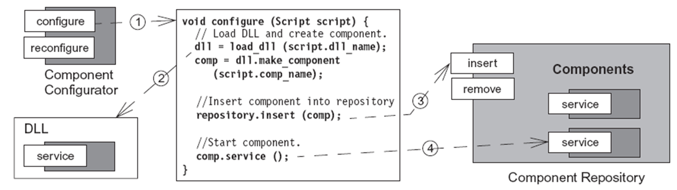
Example ACE Frameworks
Service Configurator – Static/dynamic configuration of service components
void configure(Script s) {
// Load DLL & create service
dll = dlopen(dll_name); svc = dll.make_svc (s.svc_name);
Service Configurator
// Insert service into repository
Service
repository.insert(svc);
// Start service
Service
Service
svc.init()
Service Repository
See www.dre.vanderbilt.edu/~schmidt/PDF/Svc-Conf.pdf for more info

Slide 70
Example ACE Frameworks
Service Configurator – Static/dynamic configuration of service components
void configure(Script s) {
// Load DLL & create service
dll = dlopen(dll_name); svc = dll.make_svc (s.svc_name);
Service Configurator
// Insert service into repository
Service
repository.insert(svc);
// Start service
Service
Service
svc.init()
Service Repository
Commonality: Common interface for controlling service lifecycles & a scripting language for interpreting service directives
Variability: Supports different number, type/implementation, & order of service configuration & different dynamic linking/unlinking implementations

Slide 71
Example ACE Frameworks
Task – Active objects for queueing & processing messages concurrently
Insert message into Queue
Pass message to Task
MSG
Task
1
put
2
enqueue
Client
MSG
3
dequeue
svc
MSG
Remove message from Queue & process it concurrently
See www.dre.vanderbilt.edu/~schmidt/PDF/ACE-concurrency.pdf for more info

Slide 72
Example ACE Frameworks
Task – Active objects for queueing & processing messages concurrently
Pass message to Task
MSG
Task
1
put
2
enqueue
Client
MSG
3
dequeue
MSG
Remove message from Queue & process it concurrently
Commonality: Common interface for queueing & processing of messages concurrently within a single address space
Variability: Supports different concurrency, synchronization, & memory management strategies

Slide 73
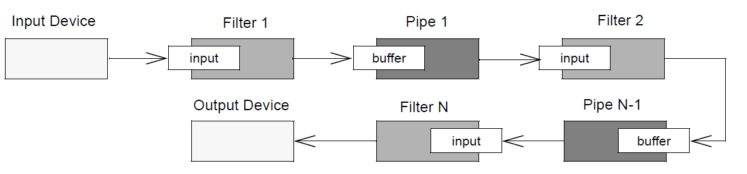
Example ACE Frameworks
Streams – Composition & processing of layered services
Input Source
Module/Task
Message Queue
Module/Task
put/svc
enqueue()
put()/svc()
enqueue/dequeue
put/svc
Output Sink
Module/Task
Message Queue
put()/svc()
put/svc
enqueue()
enqueue/dequeue
Stream
See www.dre.vanderbilt.edu/~schmidt/PDF/DSEJ-94.pdf for more info

Slide 74
Example ACE Frameworks
Streams – Composition & processing of layered services
Input Source
Module/Task
Message Queue
Module/Task
put/svc
enqueue()
put()/svc()
enqueue/dequeue
put/svc
Output Sink
Module/Task
Message Queue
put()/svc()
put/svc
enqueue()
enqueue/dequeue
Stream
Commonality: Common interface for layered service composition & message passing between Tasks
Variability: Supports different number, type/implementation, & order of services composed & different layered concurrency architectures

Slide 75
Summary
ACE’s frameworks support inversion of control & embody many commonalities & variabilities of concurrent & networked software
Application-specific functionality
Acceptor- Connector
Streams
Service Configurator
Reactor
Task
Proactor

Slide 76
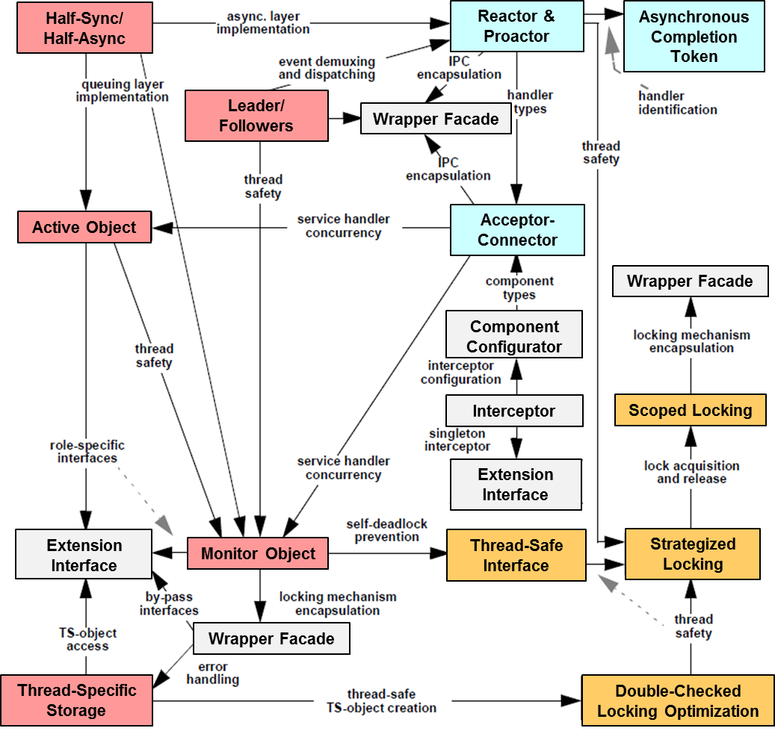
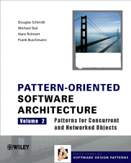
Summary
ACE’s frameworks support inversion of control & embody many commonalities & variabilities of concurrent & networked software
The ACE frameworks are based on a pattern language that helps to
Preserve crucial design information used by apps & middleware frameworks
Facilitate reuse of proven software designs
Guide design choices for app developers

Slide 77
Framework Examples: Part 4
Douglas C. Schmidt
d.schmidt@vanderbilt.edu
www.dre.vanderbilt.edu/~schmidt
Professor of Computer Science
Institute for Software Integrated Systems Vanderbilt University Nashville, Tennessee, USA

Slide 78
Topics Covered in this Part of the Module
Application-specific functionality
Present Scope, Commonality, & Variability (SCV) analysis as a method for developing & applying software product-lines & frameworks
Illustrate the application of SCV to the Android & ACE platforms
Describe examples of Android framework components
Describe examples of ACE framework components
Examine an example of the ACE Streams framework
Acceptor- Connector
Streams
Service Configurator
Reactor
Task
Proactor

Slide 79
Overview of the ACE Streams Framework
The ACE Streams framework allows flexible configuration of layered processing modules
An ACE_Stream contains a stack of ACE_Modules

Slide 80
Overview of the ACE Streams Framework
The ACE Streams framework allows flexible configuration of layered processing modules
An ACE_Stream contains a stack of ACE_Modules
Each ACE_Module contains two ACE_Tasks
i.e., a “read” & a “write” task
Task_{1W}
Task_{1R}
Module₁
Task_{2W}
Task_{2R}
Module₂
Task_{3W}
Task_{3R}
Module₃
Task_{4W}
Task_{4R}
Module₄

Slide 81
Overview of the ACE Streams Framework
The ACE Streams framework allows flexible configuration of layered processing modules
An ACE_Stream contains a stack of ACE_Modules
Each ACE_Module contains two ACE_Tasks
i.e., a “read” & a “write” task
ACE_Tasks communicate by passing messages
Task_{1W}
Task_{1R}
Module₁
MSG
MSG
Task_{2W}
Task_{2R}
Module₂
MSG
Task_{3W}
Task_{3R}
Module₃
MSG
Task_{4W}
Task_{4R}
Module₄

Slide 82
Overview of the ACE Streams Framework
The ACE Streams framework allows flexible configuration of layered processing modules
An ACE_Stream contains a stack of ACE_Modules
Each ACE_Module contains two ACE_Tasks
i.e., a “read” & a “write” task
ACE_Tasks communicate by passing messages
Each ACE_Task contains an ACE_Message_Queue & an ACE_Thread_Manager
An ACE_Task can thus be an active or passive object
Task_{1W}
Task_{1R}
Module₁
MSG
MSG
Task_{2W}
Task_{2R}
Module₂
MSG
Task_{3W}
Task_{3R}
Module₃
MSG
Task_{4W}
Task_{4R}
Module₄
See en.wikipedia.org/wiki/STREAMS for info on System V STREAMS

Slide 83
Key Patterns in the ACE Streams Framework
The ACE Streams framework implements the Pipes and Filters pattern
Each processing step is encapsulated in a filter component
Data is passed through pipes between adjacent filters

Slide 84
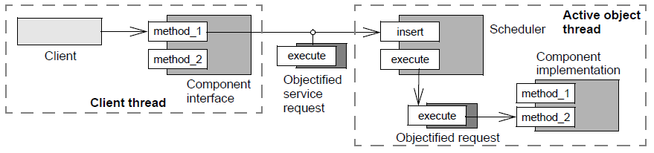
Key Patterns in the ACE Streams Framework
The ACE Streams framework implements the Pipes and Filters pattern
Each processing step is encapsulated in a filter component
Data is passed through pipes between adjacent filters
Filters in the ACE Stream framework implement the Active Object pattern
Define units of concurrency to be service requests on objects
Run service requests on an object in a different thread from requester

Slide 85
ACE Streams Example
Example program copies stdin to stdout via the use of a multi-threaded ACE_Stream that implements a “bounded buffer” as follows
Consumer Module
Producer Module

Slide 86
ACE Streams Example
Example program copies stdin to stdout via the use of a multi-threaded ACE_Stream that implements a “bounded buffer” as follows
An active Task_{1R} (producer) reads data from stdin & creates message
Consumer Module
2: svc()
Task_{1R}
MSG
Producer Module
1: read()

Slide 87
ACE Streams Example
Example program copies stdin to stdout via the use of a multi-threaded ACE_Stream that implements a “bounded buffer” as follows
An active Task_{1R} (producer) reads data from stdin & creates message
Task_{1R} passes the message to it another active Task_{2R} (consumer)
Consumer Module
Task_{2R}
MSG
3: put()
2: svc()
Task_{1R}
Producer Module
1: read()

Slide 88
ACE Streams Example
Example program copies stdin to stdout via the use of a multi-threaded ACE_Stream that implements a “bounded buffer” as follows
An active Task_{1R} (producer) reads data from stdin & creates message
Task_{1R} passes the message to it another active Task_{2R} (consumer)
Task_{2R} inserts the message into a queue
Consumer Module
Task_{2R}
Queue
MSG
3: put()
2: svc()
Task_{1R}
Producer Module
1: read()

Slide 89
ACE Streams Example
Example program copies stdin to stdout via the use of a multi-threaded ACE_Stream that implements a “bounded buffer” as follows
An active Task_{1R} (producer) reads data from stdin & creates message
Task_{1R} passes the message to it another active Task_{2R} (consumer)
Task_{2R} inserts the message into a queue
Task_{2R} removes the message from the queue & writes it to stdout
5: write()
Consumer Module
MSG
Task_{2R}
4: svc()
Queue
3: put()
2: svc()
Task_{1R}
Producer Module
1: read()

Slide 90
ACE Streams Example
Example program copies stdin to stdout via the use of a multi-threaded ACE_Stream that implements a “bounded buffer” as follows
An active Task_{1R} (producer) reads data from stdin & creates message
Task_{1R} passes the message to it another active Task_{2R} (consumer)
Task_{2R} inserts the message into a queue
Task_{2R} removes the message from the queue & writes it to stdout
Since the data/control flow is uni-directional the “write” ACE_Task is ignored
5: write()
Consumer Module
MSG
Task_{2R}
4: svc()
Queue
3: put()
2: svc()
Task_{1R}
Producer Module
1: read()
This is an example of a Task-based concurrency architecture

Slide 91
Producer Class Definition
typedef ACE_Stream<ACE_MT_SYNCH> MT_Stream;
typedef ACE_Module<ACE_MT_SYNCH> MT_Module;
typedef ACE_Task<ACE_MT_SYNCH> MT_Task;
class Producer : public MT_Task {
public:
// Initialize Producer.
virtual int open (void *) {
activate ();
}
// Read data from stdin & pass upstream
virtual int svc (void);
// ...
};
Define thread-safe typedefs using C++ traits
Make the Producer run as an active object

Slide 92
Producer::svc() Implementation
Runs as an active object in a separate thread
int Producer::svc (void) {
for (;;) {
ACE_Message_Block *mb = new ACE_Message_Block (BUFSIZ);
ssize_t n = ACE_OS::read (ACE_STDIN,
mb->wr_ptr (),
mb->size ());
if (n <= 0) {
mb->length (0);
this->put_next (mb);
break;
} else {
mb->wr_ptr (n);
this->put_next (mb);
}
}
}
Allocate a new message & read buffer of data from stdin
Keep reading stdin, until we reach EOF
Send shutdown message to other
thread & exit
Send the message to the other thread

Slide 93
Consumer Class Definition
class Consumer : public MT_Task {
public:
// Initialize Consumer.
virtual int open (void *) {
activate ();
}
virtual int put (ACE_Message_Block *mb, ACE_Time_Value *tv) {
return putq (mb, tv);
}
// Receive message from downstream & print to stdout
virtual int svc (void);
};
Make the Consumer run as an active object
Enqueue the message on the Message_Queue for subsequent processing in svc() hook method

Slide 94
Consumer::svc() Implementation
Consumer::svc (void) {
ACE_Message_Block *mb = 0;
for (;;) {
int result = getq (mb);
if (result == -1) break;
int length = mb->length ();
if (length > 0)
ACE_OS::write (ACE_STDOUT, mb->rd_ptr (), length);
mb->release ();
if (length == 0) break;
}
}
Keep looping, blocking until there’s a message on the queue & then write it to stdout
The Producer sends a 0-sized message to inform the Consumer to stop reading & exit

Slide 95
Main Driver Program for the Example
int main (int argc, char *argv[])
{
MT_Stream stream;
stream.push (new MT_Module ("Consumer", 0, new Consumer);
stream.push (new MT_Module ("Producer", 0, new Producer));
ACE_Thread_Manager::instance ()->wait ();
return 0;
}
Create Producer & Consumer Modules & push them onto the Stream, which calls the open() hook methods on their reader Tasks
All processing is performed in the Stream after push() calls complete
Barrier synchronization: wait for threads in ACE_Tasks to exit, then return from the main thread
Note the “inversion of control” in the ACE Streams framework

Slide 96
Summary
Structuring ACE_Tasks via an ACE_Stream allows “interpositioning”
i.e., similar to adding a filter in a UNIX pipeline
Task_{3R}
Consumer Module
Task_{1R}
Producer Module

Slide 97
Summary
Structuring ACE_Tasks via an ACE_Stream allows “interpositioning”
i.e., similar to adding a filter in a UNIX pipeline
New functionality may be added by pushing a new processing ACE_Module onto an ACE_Stream
e.g.:
Task_{3R}
Consumer Module
Task_{2R}
Filter Module
Task_{1R}
Producer Module
stream.push (new MT_Module ("Consumer", 0, new Consumer));
stream.push (new MT_Module ("Filter", 0, new Filter));
stream.push (new MT_Module ("Producer", 0, new Producer));

Slide 98
Summary
Structuring ACE_Tasks via an ACE_Stream allows “interpositioning”
i.e., similar to adding a filter in a UNIX pipeline
New functionality may be added by pushing a new processing ACE_Module onto an ACE_Stream
e.g.:
Note “anonymous” message communication between layers in a stream
Task_{3R}
Consumer Module
MSG
Task_{2R}
Filter Module
MSG
Task_{1R}
Producer Module
stream.push (new MT_Module ("Consumer", 0, new Consumer));
stream.push (new MT_Module ("Filter", 0, new Filter));
stream.push (new MT_Module ("Producer", 0, new Producer));
See www.dre.vanderbilt.edu/~schmidt/PDF/DSEJ-94.pdf for more info

